Slide 1
Developing the world’s most productive and admired workforces
Notes:
Innovating corporate learning

Slide 2
Agenda
Introductions
Why OpenSesame
Marketplace Model
OpenSesame Plus
LMS Integration and Support
Ouctomes
Q&A

Slide 3
What challenges are organizations facing?
Who are their learners? What is most important to them?
What are the organization's goals & objectives?
How does elearning fit into their L&D strategy?
How will organizations use L&D to adapt to market changes?

Slide 4
The new normal of working
Why? Enterprise
Notes:
Before the past few months, we’d be talking about how the business world is changing rapidly with digital transformation (which is still true).
Technology, generational transition, and competition are driving change more quickly than ever before. All of this is driving an urgent desire to mold better businesses.
Well-known HR analyst Josh Bersin, said in 2018:
“Technology is advancing at an unprecedented rate and these innovations have completely transformed the way we live, work and communicate.
Ultimately, the digital world of work has changed the rules of business.
Organizations should shift their entire mind-set and behaviors to ensure they can lead, organize, motivate, manage and engage the 21st century workforce, or risk being left behind.
Now, though, the new normal of working has a new meaning and we’ve seen accelerated change towards elearning
It’s not a time to be paralyzed. It’s a time to make a change so you and your workforce are better prepared for the future.
[next slide]

Slide 5
The future of workplace learning
With workplaces rapidly becoming more virtual, companies are revisiting standards for working and learning.
Even as travel bans, stay-at-home orders and social distancing guidelines ease, instructor-led and in-person training or conferences will be slow to recover.
More organizations will adopt elearning as a core and permanent part of their employee training programs.
Notes:
As a result of the COVID pandemic, we are seeing accelerated change in workplace learning.
[Question to prospect]: What’s been the effects on your organization the past few months?

Slide 6
The new normal of working
Why? Enterprise
100%
=
Remote working in 2020
Notes:
Remote Work Is Increasing
A special analysis done by FlexJobs and Global Workplace Analytics found that there has been a major upward trend in the amount of people working remotely in the U.S. In the span of one year, from 2016 to 2017, remote work grew 7.9%. Over the last five years it grew 44% and over the previous 10 years it grew 91%.
Between 2005 to 2017, there was a 159% increase in remote work. In 2015, 3.9 million U.S. workers were working remotely. Today that number is at 4.7 million, or 3.4% of the population. And with COVID, this increased dramatically. In fact, many experts believe many businesses will transition to remote first policies or drastically increase the amount of remote workers in general, even after the pandemic subsides.
https://www.flexjobs.com/blog/post/remote-work-statistics/

Slide 7
The new normal of training
Why? Enterprise
59% of learning and development pros spend more of their budget on online training than they did three years ago.
Over a third of them also spend less on instructor-led training (ILT).
Notes:
With more workers working from home, training normally done in person will also need to change.
L&D professional are spending more on online training than three years ago, and this study was done BEFORE COVID.
As a result, they are spending less on in-person instructor-led training.

Slide 8
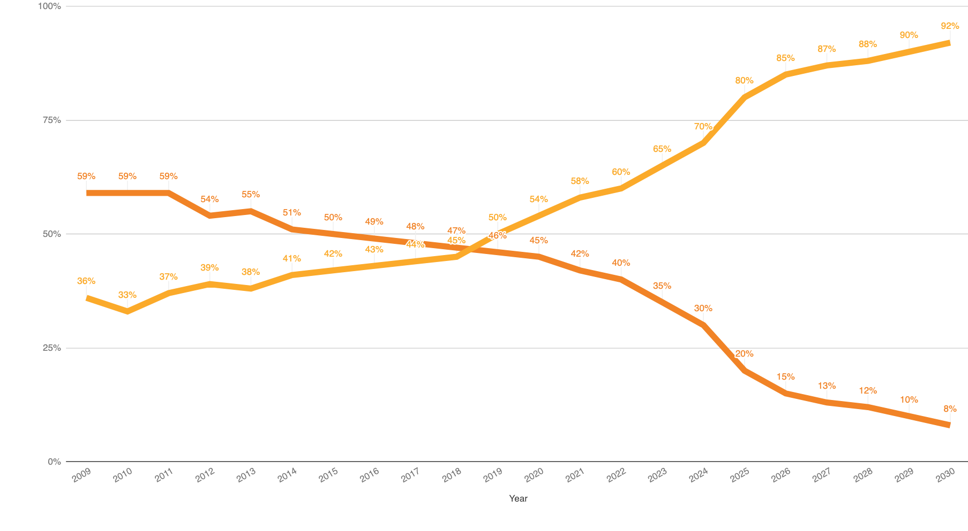
Training hours rapidly shifting from classroom to online
Instructor led classroom (hours)
COVID?
Technology Delivered (hours)
http://elearningindustry.com/new-report-on-e-learning-market-trends-and-forecast-2014-2016-just-released
Source: Bersin (2014); Future projection based on trend
Notes:
As you can see, this has been a major shift in changing the corporate training experience over the past few years from classroom to more elearning. eLearning is now the most efficient way for workers to gain skills anytime and anywhere.
With COVID, we see and anticipate continued acceleration of this shift (see the grey lines)

Slide 9
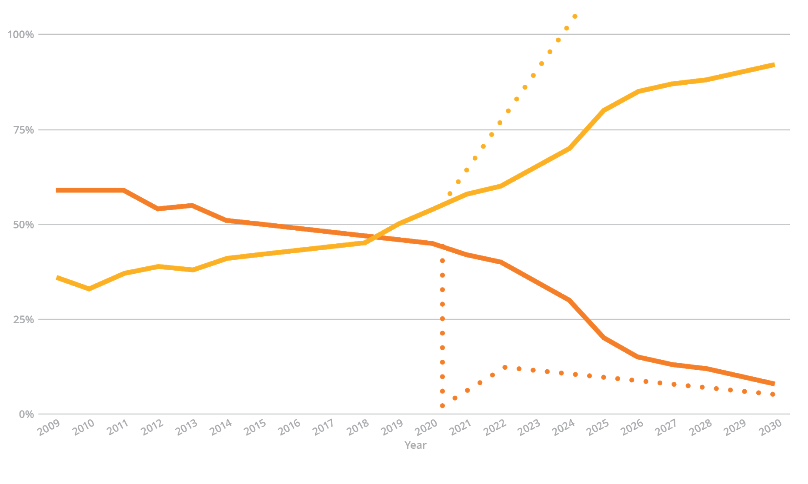
Training hours rapidly shifting from classroom to online
Instructor led classroom (hours)
Technology Delivered (hours)
Effect of COVID-19
http://elearningindustry.com/new-report-on-e-learning-market-trends-and-forecast-2014-2016-just-released
Source: Bersin (2014); Future projection based on trend
Notes:
As you can see, this has been a major shift in changing the corporate training experience over the past few years from classroom to more elearning. eLearning is now the most efficient way for workers to gain skills anytime and anywhere.
With COVID, we see and anticipate continued acceleration of this shift (see the grey lines)

Slide 10
Time & geography are less relevant now
Why? Enterprise
Blend online learning with in-person training
Online pre-course work
In-person or video conference training
Study group video conferences
Online post-training reinforcement
Notes:
But in-person learning is not going away. Blending elearning with ILT has been happening for years. Here are some examples of how blending of training is happening.

Slide 11
How OpenSesame can help you
Why? Enterprise
+
+
Curation
We are elearning advisors who curate the right courses for customers and guide them through improving elearning utilization and employee engagement.
Content Variety
With more than 20,000 courses, OpenSesame offers the most comprehensive catalog of curated elearning courses in a variety of formats and languages.
Support
We are fanatical about supporting our customers and set the industry standard for service:
15 seconds via chat, 15 minutes via email.

Slide 12
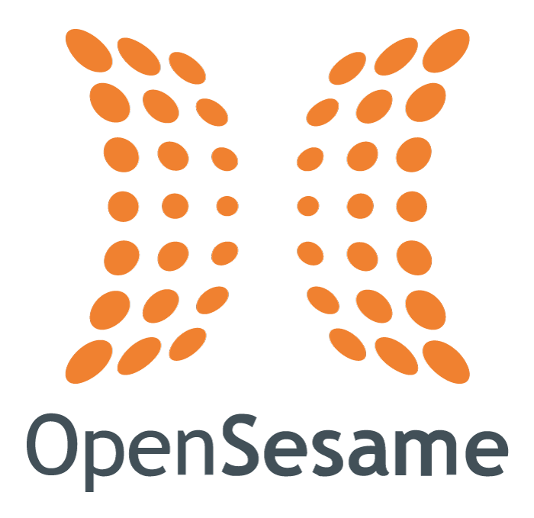
Enterprise Learning Ecosystem
Companies
Content Delivery Systems
Learning Management Systems (LMSs)
eLearning Courses
Learning experience platform
100,000s of companies adopting eLearning
Over 900 LMSs delivering content
Learning record store
1000’s of publishers
Notes:
And the ecosystem of technologies you have at your fingertips has grown exponentially.
As 100,000’s of companies have been adopting elearning, the way they have been delivering elearning content to their learners has been evolving. Not only are companies using the trusted LMS but also innovative platforms such as learning experience platforms and learning record stores that allow you to collect both formal and informal learning into one place.
At OpenSesame, we’ve been able to simplify this complex world for our customers. We bring together the delivery systems with the elearning courses and publishers for our customers so you can focus on your people and L&D challenges, not the technology.
So, what are the most common challenges we see? (click)

Slide 13
Common challenges
Why? Enterprise
Varying quality of courses
Different learning styles
Keeping courses updated
Managing multiple vendors, contracts
LMS integration
Finding courses you need
Notes:
Hundreds of companies every day come to us for help in overcoming the challenges they face to adapt to this new business reality. Here are the six most common ones we hear.
[indicate which ones they cited as challenges for them: “just as I heard from you, [fill in the blank] is a common concern….]
[indicate ones they did not mention and ask if any of these resonate with them]
Finding courses you need- once you know the business objectives your company has, a large part of any L&D professional’s role is to find and select the training to help their organization achieve those objectives. There are many, many elearning courses out there to choose from, and, as we hear all the time, the challenge is more about evaluating and curating courses, not finding them. [is this a challenge at your company?]
Varying quality of courses- As you are evaluating courses, one of the most commonly used criteria your peers look at is the quality of courses. Yet, how do you evaluate courses? Will your stakeholders and learners have the same perspective when evaluating a course? How do you rate the quality of many courses at once? [is this a challenge at your company?]
Different learning styles- You have a diverse group of learners. Perhaps, you are training employees who are at different stages of their careers, speak different languages, are baby boomers or millenials, sit at a desk or work in the field/warehouse/someplace without a desk computer, have only short periods of time to learn or can set aside the whole day for training…. How do you meet the different learning styles and needs of all of your learners? [is this a challenge at your company?]
Keeping courses updated -Although a lot of time and energy is spent finding and evaluating courses, the work doesn’t stop there. Many people we work with have significant challenges keeping courses updated. Whether changes are needed for new regulatory requirements or to update the look and feel of a training course, making those changes can be a daunting task if your time and resources are limited. [is this a challenge at your company?]
Managing multiple vendors, contracts- Because of the diverse needs of your workforce, you may have multiple vendors you work with today to assemble the courses you need for your training programs. Many of our customers struggle with the administrative nightmare of setting multiple vendors up with procurement, requisitioning purchase orders and approving invoices for multiple vendors. [is this a challenge at your company?]
LMS integration- Most of our customers are using a learning management system (LMS) to deploy elearning and track their training programs. Given the complexity of LMS systems, the IT complexity of integrating elearning courses (let alone from multiple vendors) with a LMS can be a huge pain point for L&D managers. [is this a challenge at your company?]
Transition: With challenges like these, you could use some help! Let’s discuss how OpenSesame can help you….

Slide 14
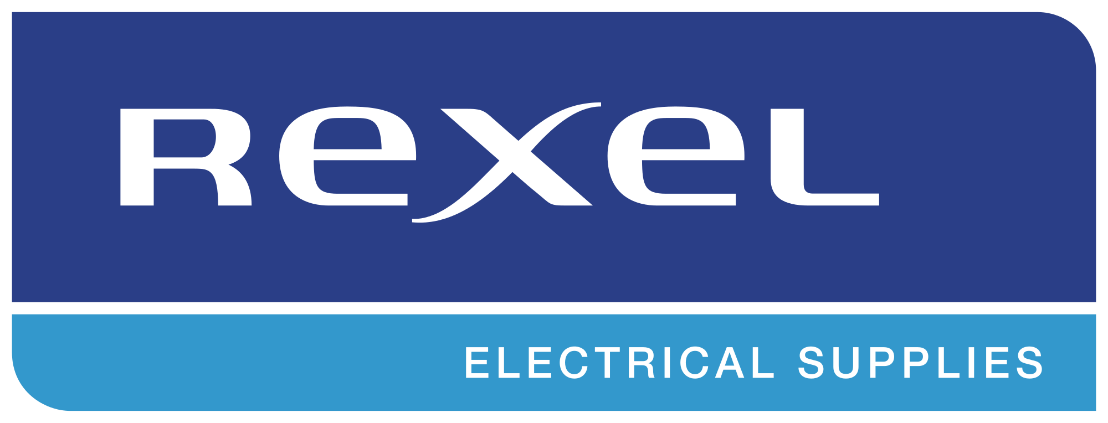
The emerging world leader in enterprise elearning
Now serving
100+
Global 2000 and Fortune 1000 enterprises
Notes:
Top Global 2k/Notable Customers Highlight

Slide 15
Business Skills
Leadership / Management
Accounting
Telephone Skills
Time Management
Sales
Communication
Technology
Microsoft Office
Desktop
Social Media
IT
Cisco
Web Development
Safety
Workplace Safety OSHA
Fire Safety
Forklift Safety
Defensive Driving
Certifications
Microsoft Certification
Project Management (PMI / PMBOK)
Human Resources
CompTIA
Most comprehensive catalog from world’s top publishers
Compliance
Ethics
GDPR
Privacy
Cybersecurity
Code of Conduct
Bribery & Corruption
Harassment Prevention
Industry Specific
Finance
Healthcare
Hospitality
Banking
Manufacturing
Oil & Gas
Foreign Languages
Diversity, Equity & Inclusion
Unconscious Bias
Inclusive Leadership
Mental Health Awareness
Building Diverse Teams
Generational Diversity
Intercultural Competence
Wellness
Corporate Wellness
Stress Management
Mindfulness and Meditation
Exercise and Fitness
Resilience
Work/Life Management

Slide 16
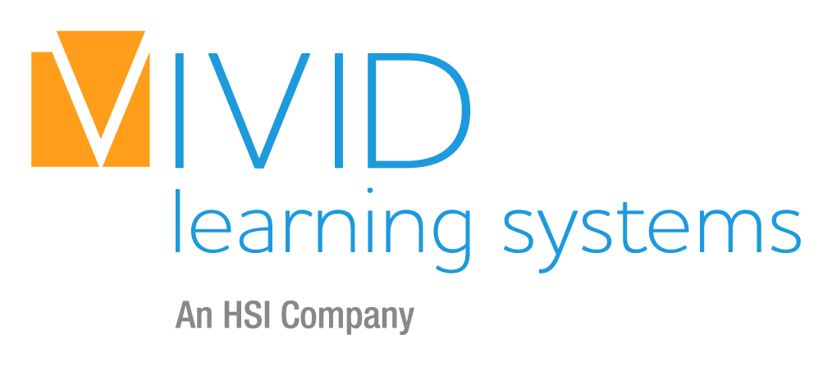
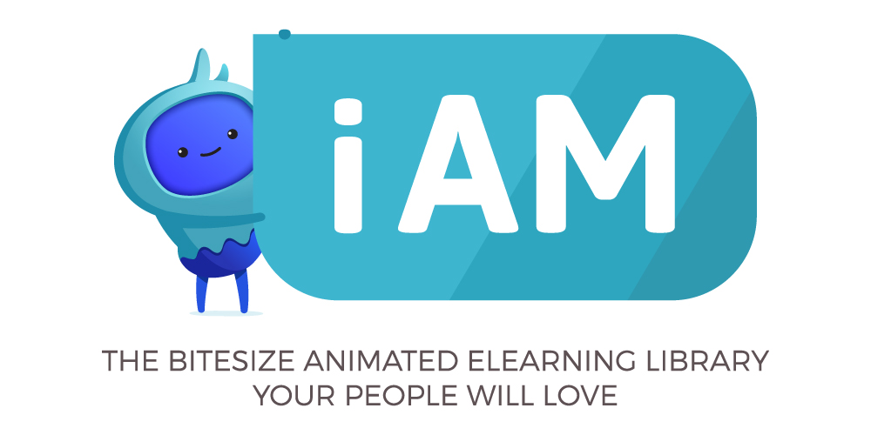
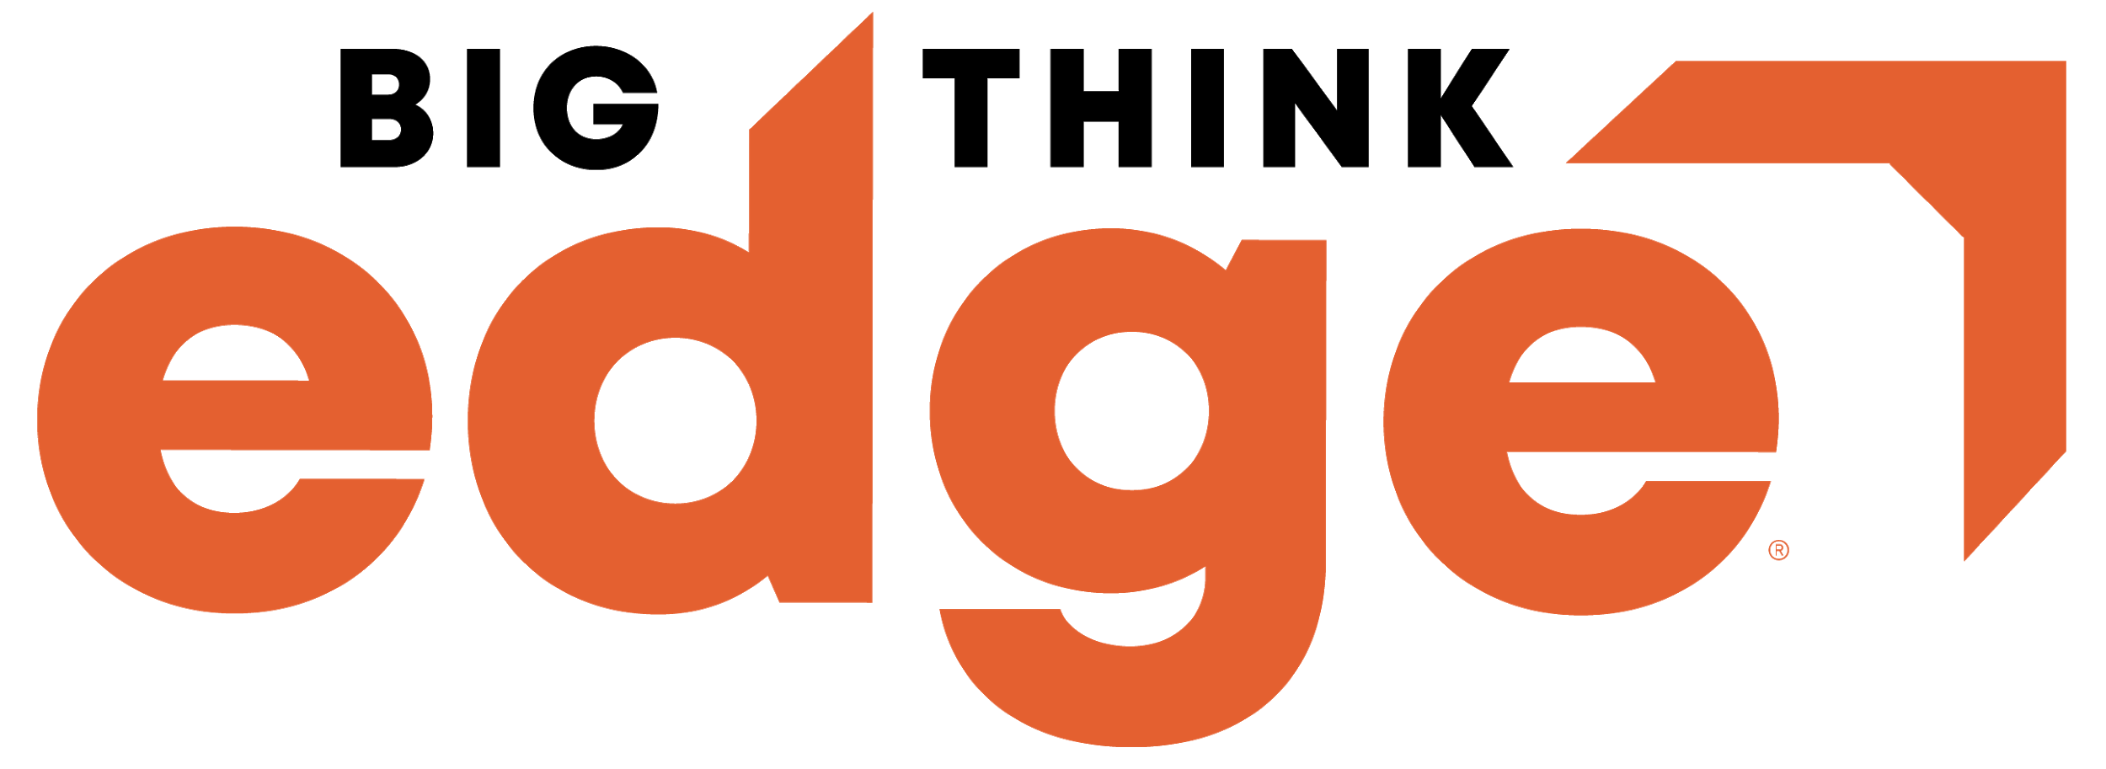
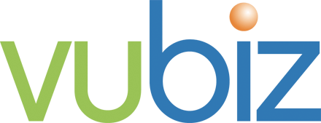
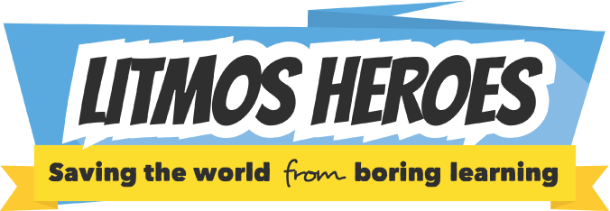
OpenSesame Plus Product Evolution
13,000+ courses
2,275 courses
2013 – 2019
2020
2021
Notes:
200+ New courses per month.

Slide 17
Get unlimited access to the training courses you need — all for one low price
10,000+ training courses
No worrying about
cost per course
Use what you need, when you need it
Integrate with
your LMS
Notes:
If you are wondering if you’d even use 20,000 courses at your company, don’t worry! Most of our customers don’t use ALL of these courses. What’s important is that there 20,000 courses from you to choose from, as your organization changes, grows. Our most popular subscription, OpenSesame Plus offers you a broad-based catalog of more than 10,000 courses. You won’t need to worry about paying per course and only use what you need when you need it.
If you need a course that’s not in the OpenSesame Plus catalog, then you can easily add on courses from the larger OpenSesame 20,000 course catalog. We offer you this flexibility to add on so you can optimize your training programs and offer a variety of elearning content. You’ll be able to pay per use or purchase courses in volume.

Slide 18
Why is content variety important?
“L&D departments often waste time focusing on the wrong things in materials design, [such as] focusing on imposing uniformity across learning materials. This is not only a time consuming activity, it is potentially detrimental to learning.
...Variation makes a substantial difference to the learning.
How can we maintain motivation and make the content naturally appealing? …. our visual sense is highly important to grab our attention, and that materials should also be differentiated from each other.”
Donald H Taylor, Chairman, Learning and Performance Institute
DonaldHTaylor
Notes:
With all of these courses, we are able to offer a variety of courses. You may be thinking why is variety in your training content important? Shouldn’t all the courses look and feel the same?
Donald Taylor, Chairman of the Learning and Performance Insitute, remarks that L&D has long been trained to focus on imposing uniformity across learning materials. [click]
When, in factor, variation makes a substantial difference in how adults learn. The more differentiated training is, the higher the retention of the knowledge gained from the training. So, having courses that look and interact with the learner differently will help ensure the effectiveness of your training.
QUESTION: I have a white paper that Donald writes on this fascinating topic. Is that something you’d be interested in reading? I can send it to you!

Slide 19
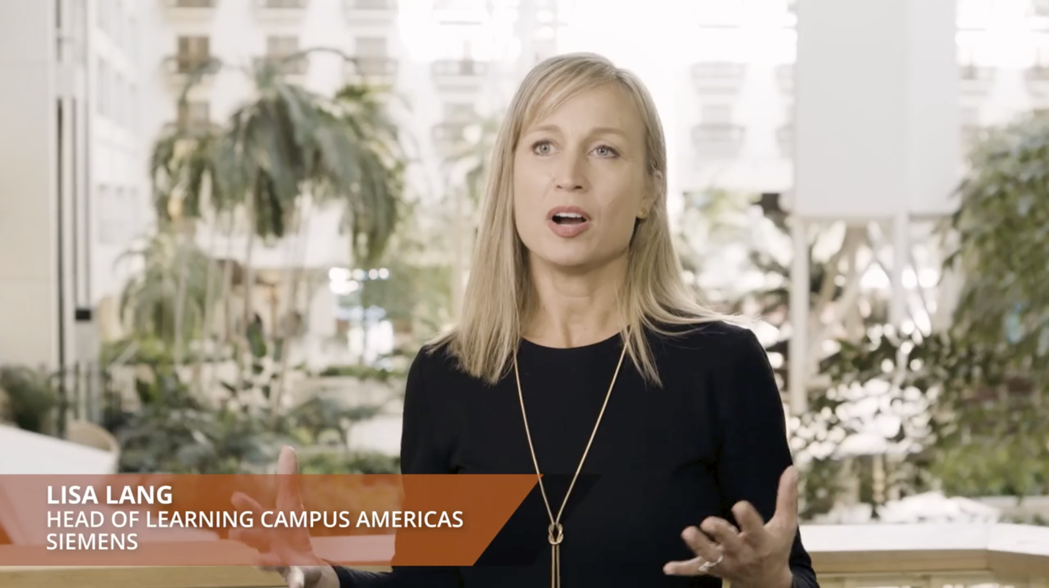
"OpenSesame curates the courses for us, so we can focus on the more strategic part of our jobs."
Notes:
Finding, evaluating and selecting the right courses for your training initiatives, core competencies, and learners can be overwhelming. I mentioned earlier that curation is a key part of what we do for you. In fact, we have a dedicated content curation team at OpenSesame who is focused on just that.
QUESTION: how much time do you and your L&D team spend each week finding, evaluating, curating courses? How would having a team of curation experts help you improve your effectiveness and productivity?
Let us help you like we do for Siemens--- As Lisa Lang of Siemens who is the Head of the Learning Campus in the Americas remarks, let us help you curate courses so you can be more strategic partners to the business.
QUESTION: I have the video featuring Lisa and her team at Siemens and how they are improving productivty at Siemens with their training programs. Would you like to see it?

Slide 20
How do you find courses your company needs?
Notes:
It takes time to curate the courses you need and work with your stakeholders to evaluate courses for their constituents. So, we offer more the courses. As part of our service to our customers, we assist with curation of courses when you launch and throughout your time with us as a customers.
So, how do we help you find the courses you need?

Slide 21
Curation alignment process
GATHER INPUT
AGGREGATE FEEDBACK
CURATE
IMPROVE
Notes:
We use a proven process for curation: the content alignment process.
Here are the steps we follow to ensure you select the courses best suited for your learners:
Identify reviewers
Provide reviewer list (name & contact info) to your OpenSesame CSM (can be segmented by domain)
Email invite to CAP to reviewers
Each reviewer rates each publisher based on their style preferences (~ 30 mins to complete)
Results & preferences review (can be segmented by domain)
Curation next steps (can be segmented by domain) - based on topics & style preferences

Slide 22
Smart Lists: machine learning-driven curation
Notes:
We don’t stop there.
We’ve build course recommendation tools into our website, called Smart Lists. Smart Lists enable machine-learning driven curation so our recommendation algorithm takes into account your past preferences, ratings your learners have made on past courses, your industry, and more. It learns each time you select a course or a learner rates a course and improves its recommendations of courses to you.

Slide 23
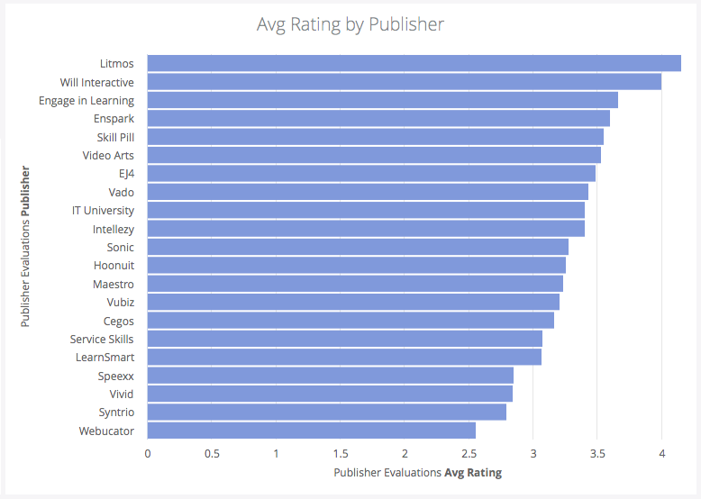
Results of your curation alignment process

Slide 24
Are your courses fresh, updated?
"Course update communication gives us confidence ... without us having to manage it on our own, as we do with other vendors."
Lori from Johnstone Supply
86%
Saved time finding, administering courses
Notes:
Just as difficult as finding the courses you need, the task of keeping them updated can be daunting for any L&D team.
In a recent OpenSesame customer survey, 86% of respondents saved time finding and administering courses after buying OpenSesame. When a publisher updates a course to meet a changing regulation, we push the update to your system so all you have to do is click a button and the course is updated.
QUESTION: how much time would you save in administering courses if updating was this easy?

Slide 25
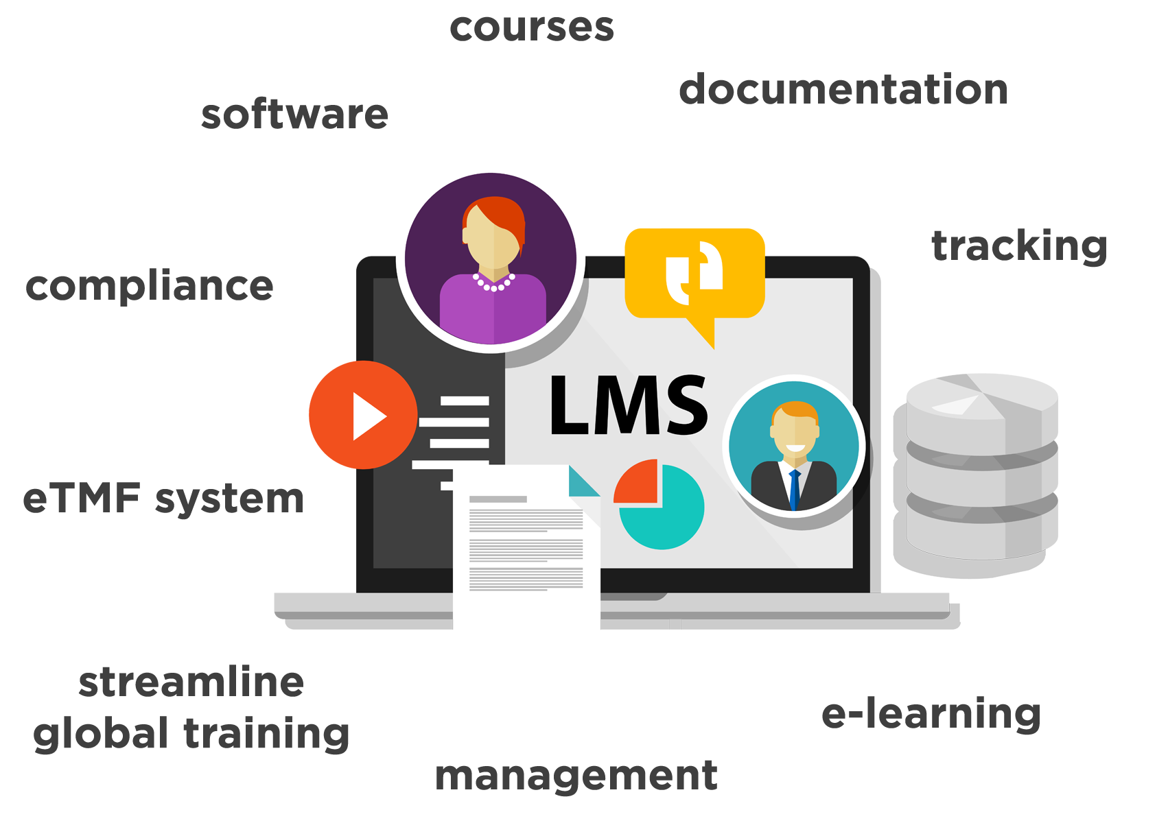
OpenSesame courses work seamlessly with any industry standards compliant LMS
Notes:
[if you know the LMS your audience has, select the appropriate slide from the Appendix]
Another way you will save time with OpenSesame will be in the integration of courses with your LMS. OpenSesame courses work seamlessly with any industry standards compliant LMS.
What does that mean? It means you will be able to:
-Preview courses, read reviews, research publishers before purchase
-Add, sync courses easily with your LMS.
-Easily assign, track courses for your learners
- Provide a seamless experience for your learners without having to use multiple, disparate systems
- See real-time reporting of courses taken, completed in your LMS
QUESTION: how much time (and headache) would you save if integration with your LMS and your elearning courses was seamless?

Slide 26
We are here to help you
PLAN
CURATE
CONFIGURE
TEST
LAUNCH
IMPROVE
Notes:
As I mentioned earlier, we don’t just help you get up and running with your initial set of elearning courses. We help you by:
Developing a strategy and plan to build the training programs your organization of the future needs
This includes curating the right courses for your diverse workforce
We ensure your learning systems are configured and tested for a successful launch
And, on an ongoing basis, we are here to help you improve your training program by increasing employee engagement and elearning utilization.
QUESTION: how much would it help you to have help with implementation, launch and ongoing improvement of your training programs?

Slide 27
The best customer support in the industry
15
seconds
via chat
Setting the
industry standard for service
Rapid response times
15
minutes
via email
Dedicated Customer Success Manager to help define and track your success
Live
via phone
Notes:
In addition to our customer success team, our technical support team is on call via phone, email or chat to answer any technical questions you OR your learners have.
Our customers rave about how quickly and thoroughly we address and resolve their questions, whether it be for an LMS administrator or an employee taking a class, problems with a course launching or integration with your LMS. We are here to help you!
QUESTION: how much would it help you and your L&D team to have a resource for your learners and LMS administrators to reach out to with technical questions?

Slide 28
Outcomes
Why? Enterprise
Deliver ROI
Maintain compliance
Save time
Engage learners

Slide 29
What our customers say
90% renewal rate
92% saw a return on their investment in less than one year
89% saved time, resources with OpenSesame curation services
75% improved L&D program administration using our LMS integrations
74% increased offering of elearning topics and courses
50% spend less internal resources, time building training courses

Slide 30
Our customers see results
Large learning provider
$118k Annual cost
$47k Annual cost
258% increase
670 course completions
2,400 course completions
84% decrease
$118 Average cost per course
$19.50 Average cost per course
Source: OpenSesame customer
Notes:
But, the really BIG question is: will you get the results you need?
Don’t just believe us. Here is a slide provided by an actual OpenSesame customer.
In this example, this OpenSesame customer examined the difference between their sourcing strategy with Skillsoft and their change to OpenSesame. With OpenSesame, they were able to free up $54,000 in their learning budget which they applied to previously unmet needs for training. In other words, they were able to get the courses they needed from OpenSesame that they had from Skillsoft at a $54,000 savings which they used to expand their training program.
Learning budgets are finite. This customer was able to demonstrate significant quantifiable savings, focus on ROI and alignment with company objectives enabling an improved learning experience and value for its employee base.
QUESTION: how would saving $ on training or expanding the reach of your training program with the same budget be viewed at your organization?

Slide 31
Return on investment
92% of OpenSesame customers saw a return on their investment in < 1 year
"Utilizing OpenSesame has helped our company by saving us more than $100,000 annually."
92%
Save
>$100K
Notes:
Similarly, in a recent survey of our customers:
92% of respondents saw a return on their investment in OpenSesame is less than 1 year.
Customers saw savings in time, money, and resources. One customer even told us they were able to save more than $100,000 annually.
QUESTION: how would your manager react if you were able to get results like these?

Slide 32
Thank you!
We are here to help you all along the way

